Slide 1
Artificial Intelligence
0-<number>

Slide 2
Artificial Intelligence
Field of Computer science that seeks to build autonomous machines - machines that can carry out complex tasks without human intervention
Requires machines to perceive and reason.
Agenda
  Intelligence and Machines
  Perception
  Reasoning
0-<number>

Slide 3
What is an agent ?
  Agent: A “device” that responds to stimuli from its environment.
  An agent is anything that perceiving its environment through sensors and acting upon that environment through actuators.
  Example:
    autonomous airplane
    a character in an interactive video game
    A robot with cameras and motors
    A thermostat detecting room temperature.
    a process communicating with other processes over
the Internet (perhaps as a client, a server, or a peer).
0-<number>

Slide 4
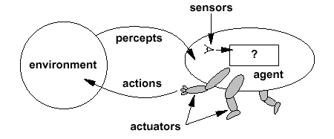
Intelligent Agents
Sensors : Microphones, cameras, range sensors, and air or soil sampling devices.
Actuators: Wheels, legs, wings, grippers, and speech synthesizers
Much of the research in artificial intelligence can be viewed in the context of building agents that behave intelligently.
0-<number>

Slide 5
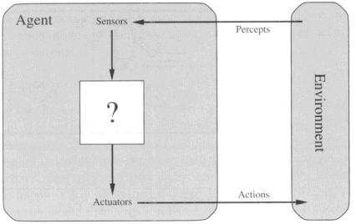
Diagram of an agent
0-<number>

Slide 6
Levels of Responses
Reflex: actions are predetermined response to the input data
  Throwing a baseball, touching fire.
More intelligent behavior requires knowledge of the environment and involves such activities as:
  Goal seeking - winning a game of chess, driving car.
  Manoeuvring through a crowded passageway
  Learning - how and where to throw the baseball requires knowledge of the current environment.
Such goal-directed behaviour requires that the agent’s response, or sequence of responses, be the result of deliberately forming a plan of action or selecting the best action among the current options.
0-<number>

Slide 7
Agent Learning
Developing Procedural knowledge ( How )
  Trial and error process.
  Agent learns appropriate actions by being punished for poor actions and rewarded for good ones.
  Developed over a time improve their abilities
  Games :- Checkers and chess, driving a car.
Storing declarative knowledge ( What )
  Expanding or altering the “facts” in an agent’s store of knowledge.
  Baseball player must repeatedly adjust his or her database of knowledge to determine rational responses to future events
0-<number>

Slide 8
Agent Understanding & Response
An agent must ,
  “understand” the stimuli received by its sensors.
  extract information from the data produced by its sensors.
  straightforward process or it might require an agent to formulate responses as complete spoken sentences.
  Be able to perceive.
  Gyroscope vs.. Understanding speech and images.
  formulate their responses in terms compatible with their actuator.
** leads to the research in image processing and analysis, natural language understanding, and speech generation
0-<number>

Slide 9
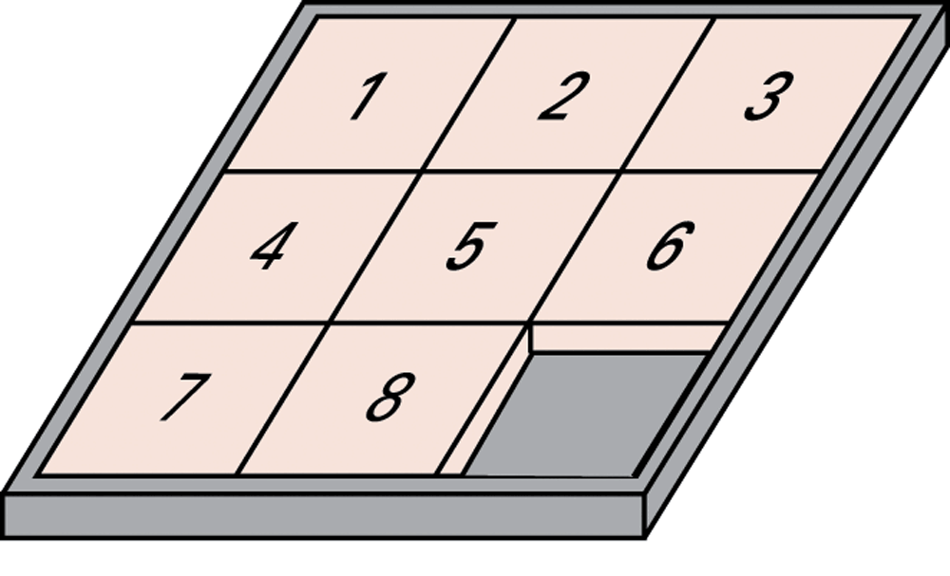
The eight-puzzle in its solved configuration
0-<number>

Slide 10
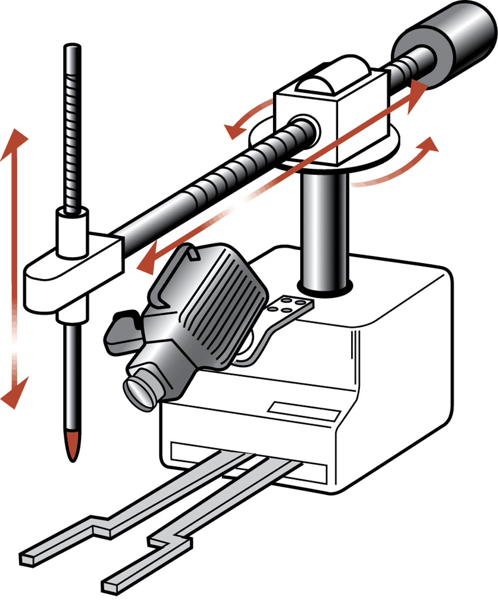
Our puzzle-solving machine
Puzzle-solving machine exhibits two of the agent attributes:
extract the current puzzle state from the image it receives from its camera ( Perceive) .
implement a plan for obtaining a goal.
0-<number>

Slide 11
Approaches to Research in Artificial Intelligence
Engineering track
  Researchers are trying to develop systems that exhibit intelligent behavior.
  Performance oriented
  Goal is to produce a product that meets certain performance goals
Theoretical track
  Researchers are trying to develop a computational understanding of animal—especially human—intelligence.
  Simulation oriented - emphasis is on process
0-<number>

Slide 12
Example
Linguists are interested in learning how humans process language (theoretical)
  operate in simulation-oriented mode-building systems
  goals are to test theories
Natural language processing research deals with developing machines to manipulate natural language (engineering)
  operate in performance-oriented mode-building systems to perform tasks (e.g. document translators, OS with verbal commands)
0-<number>

Slide 13
Turing Test
Benchmark in measuring progress in the field of artificial intelligence.
In artificial intelligence (AI), the Turing Test is a method for determining whether or not a computer is capable of thinking like a human.
Test setup: Human interrogator communicates with test subject by typewriter.
Test: Can the human interrogator distinguish whether the test subject is human or machine?
0-<number>

Slide 14
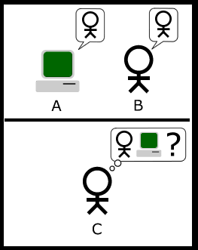
Turing Test
0-<number>

Slide 15
Turing Test : The Imitation Game
Machine
Interrogator
Human

Slide 16
The Simplified Turing Test
Interrogator
Machine or Human
“I believe that in about fifty years’ time it will be possible to program computers, with a storage capacity of about 10⁹, to make them play the imitation game so well that an average
interrogator will not have more than 70 per cent chance of making the right identification after 5 minutes of questioning”
-Alan Turing (1950)

Slide 17
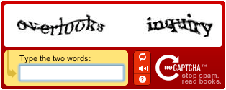
What can people do that computers can’t do?
Telling Humans and Computers Apart Automatically
A CAPTCHA is a program that protects websites against bots by generating and grading tests that humans can pass but current computer programs cannot. For example, humans can read distorted text as the one shown below, but current computer programs can't:
The term CAPTCHA (for Completely Automated Public Turing Test To Tell Computers and Humans Apart) was coined in 2000 by Luis von Ahn, Manuel Blum, Nicholas Hopper and John Langford of Carnegie Mellon University.

Slide 18
ELIZA – Chat Bot
ELIZA(DOCTOR) is a piece of software that attempts to simulate the conversation of a Rogerian psychotherapist.
It was written in the mid-1960s by Joseph Weizenbaum, a professor of computer science at MIT.
ELIZA does not pass a Turing test.
If you interact with it the conversation does not last too long before it becomes obvious you are talking to a machine.
http://nlp-addiction.com/eliza/
0-<number>

Slide 19
Perception
To respond intelligently to the input from its sensors, an agent must be able to understand that input.
The agent must be able to perceive
Understanding images and language
0-<number>

Slide 20
Understanding Images
Puzzle-solving machine.
Less Intelligence (very little precision)
  Opening and closing of the gripper.
  Camera Focus.
First intelligent behaviour
  Extraction of information through a visual medium.
  Not that of merely producing and storing an image.
  Understand the image in order to extract the current status of the puzzle.
  Limited interpretations in eight puzzle problem.
  Template Matching
0-<number>

Slide 21
Understanding Images
Optical character readers.
Drawback of Optical Character reader:
  Uniformity for the style, size, and orientation of the symbols being read.
  Physically large character does not match the template for a smaller version of the same symbol.
Imagine how the problems increase in difficulty when trying to process handwritten material.
0-<number>

Slide 22
Understanding Images
Character recognition is based on matching the geometric characteristics.
  1 might be characterized as a single vertical line, 2 might be an opened curved line joined with a horizontal straight line across the bottom and so on..,
Two Steps :
  extract the features from the image.
  compare the features to those of known symbols.
  Drawbacks ( Geometric Characteristics):
  Minor errors in the image can produce a set of entirely different geometric features.
  Difference between an O and a C or, in the case of the eight-puzzle, a 3 and an 8.
0-<number>

Slide 23
Understanding Images
Understanding the images become complex,
  three-dimensional scenes.
  overlapping images
Understanding general images
  Image processing, which refers to identifying characteristics of the image.
  image analysis, which refers to the process of understanding what these characteristics mean.
0-<number>

Slide 24
Image processing
Image processing (steps toward identifying the various components in an image).
  Edge enhancement
    Applying mathematical techniques to clarify the boundaries between regions in an image.
    Photograph into a line drawing.
  Region finding
    Identifying those areas in an image that have common properties such as brightness, color, or texture.
    Section of the image that belongs to a single object
  Smoothing
    Removing flaws in the image
    Image Analysis
      Recognizing partially obstructed objects.
0-<number>

Slide 25
Language Processing
Another perception problem that has proven challenging is that of understanding language.
Formal programming language Vs natural languages
Several Types of Analysis:
  Syntactic Analysis
  Semantic Analysis
  Contextual Analysis
0-<number>

Slide 26
Language Processing
Syntactic Analysis
  Major component is parsing.
  “Mary gave John a birthday card “ is recognized as Mary.
  Subject of “John got a birthday card from Mary” is found to be John.
  identifies the grammatical role of each word.
Semantic Analysis
  Task of identifying the semantic role of each word in the statement.
0-<number>

Slide 27
Language Processing
Contextual analysis:
Context of the sentence is brought into the understanding process.
  The bat fell to the ground.
    Identifying the action involved as falling, the agent as bat, and so on..,
    Not until we consider the context of the statement
    Example : Stampeding cattle can be dangerous.
0-<number>

Slide 28
Language Processing
Natural language processing concerns an entire document rather than individual sentences.
Information retrieval and information extraction.
Information retrieval, -task of identifying documents that relate to the topic at hand.
Example – Search items differs.
0-<number>

Slide 29
Language Processing
Information extraction, task of extracting information from documents so that it takes a form that is useful in other applications.
  Identifying the answer to a specific question
  Recording the information in a form, from which questions can be answered at a later date.
  Frame - a template in which specifics are recorded.
Semantic net, large linked data structure in which pointers are used to indicate associations among the data items.
0-<number>

Slide 30
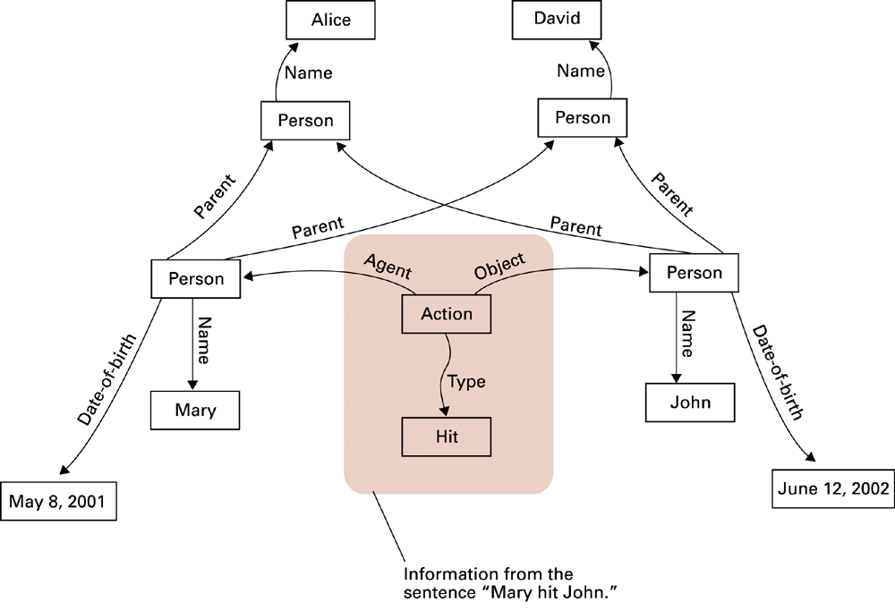
A semantic net
0-<number>

Slide 31
Reasoning- Production Systems
Reasoning : Explore techniques for developing agents with elementary reasoning abilities.
Puzzle-solving machine: machine with solutions to all possible arrangements.
Elementary reasoning activities.
Common characteristics are isolated in an abstract entity known as a production system.
0-<number>

Slide 32
Components of a Production Systems
1. Collection of states
  Start (or initial) state
  Goal state (or states)
2. Collection of productions: rules or moves
  Each production may have preconditions
3. Control system: decides which production to apply next
0-<number>

Slide 33
Reasoning by Searching
The collection of all the states, productions, and preconditions in a production system- Problem Space.
State Graph: All states and productions
Search Tree: A record of state transitions explored while searching for a goal state
  Breadth-first search
  Depth-first search
0-<number>

Slide 34
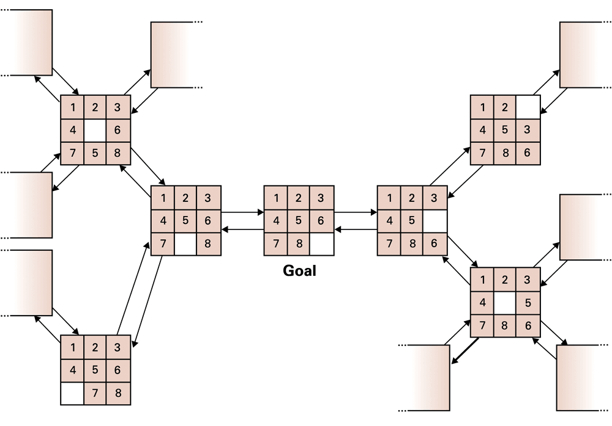
A small portion of the eight-puzzle’s state graph
0-<number>

Slide 35
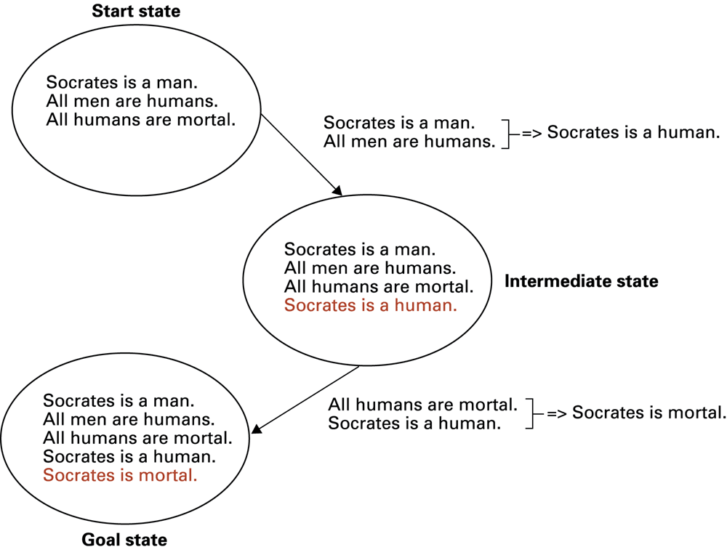
Deductive reasoning in the context of a production system
0-<number>

Slide 36
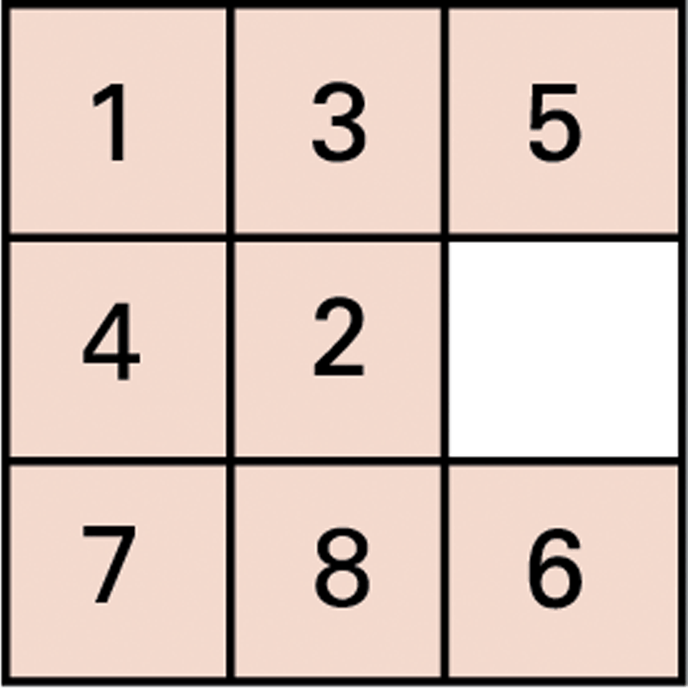
An unsolved eight-puzzle
0-<number>

Slide 37
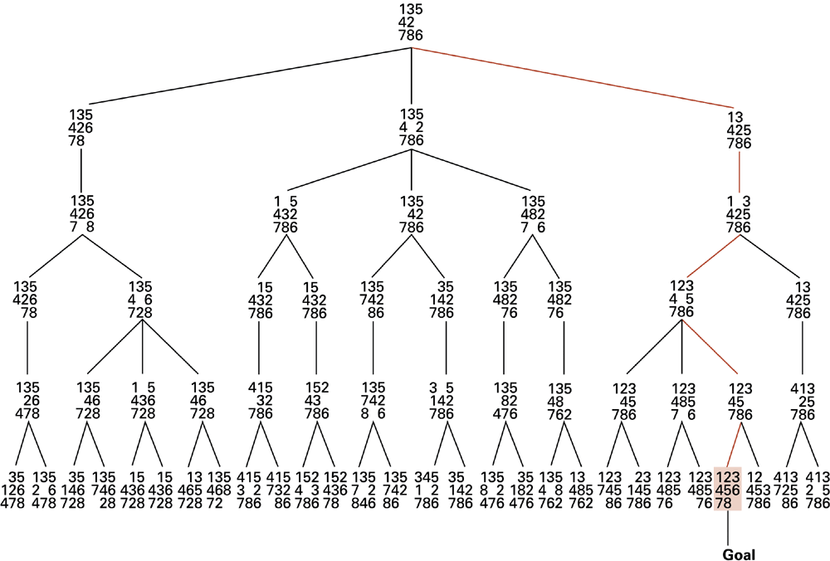
A sample search tree
0-<number>

Slide 38
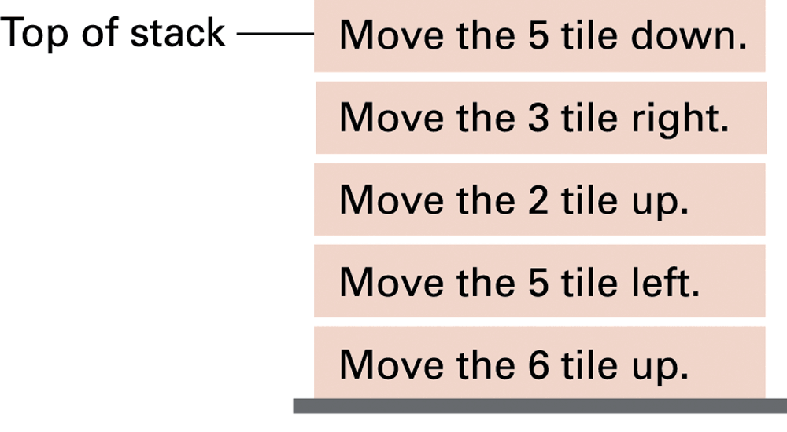
Productions stacked for later execution
0-<number>

Slide 39
Heuristics
Search tree – generation
Example – Chess Game
Breadth-first Vs Depth-first
Best-first construction - appeared most promising node in a search tree.
Way of identifying which of several states appears to be the most promising - quantitative value associated with each state – heuristic- to measure the “distance” from that state to the nearest goal.
0-<number>

Slide 40
Heuristic Strategies
Heuristic: A “rule of thumb” for making decisions
Requirements for good heuristics
  Must be easier to compute than a complete solution
  Must provide a reasonable estimate of proximity to a goal
0-<number>

Slide 41
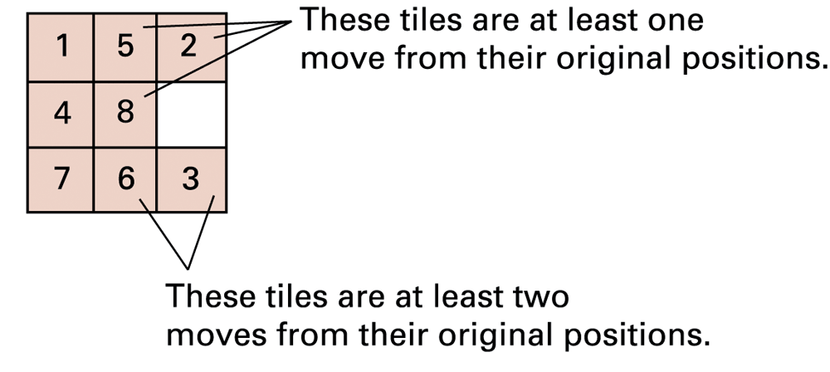
An unsolved eight-puzzle
0-<number>

Slide 42
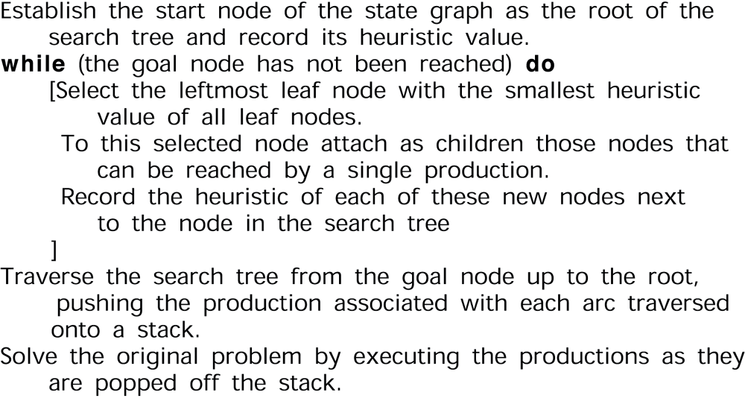
An algorithm for a control system using heuristics
0-<number>

Slide 43
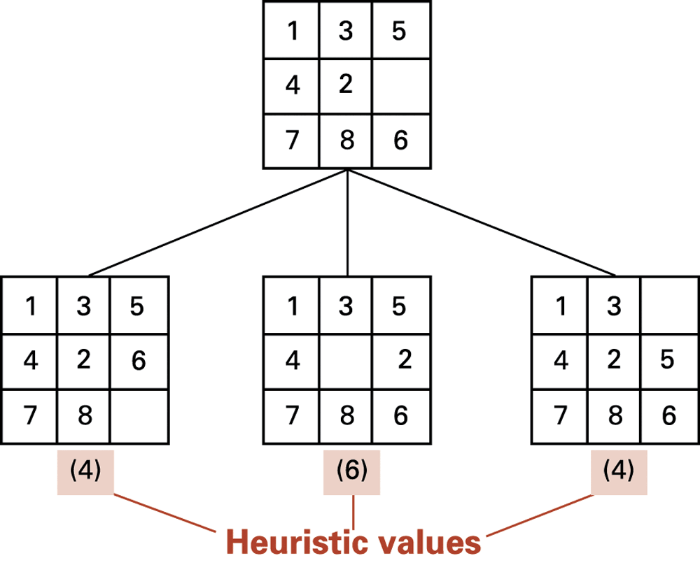
The beginnings of our heuristic search
0-<number>

Slide 44
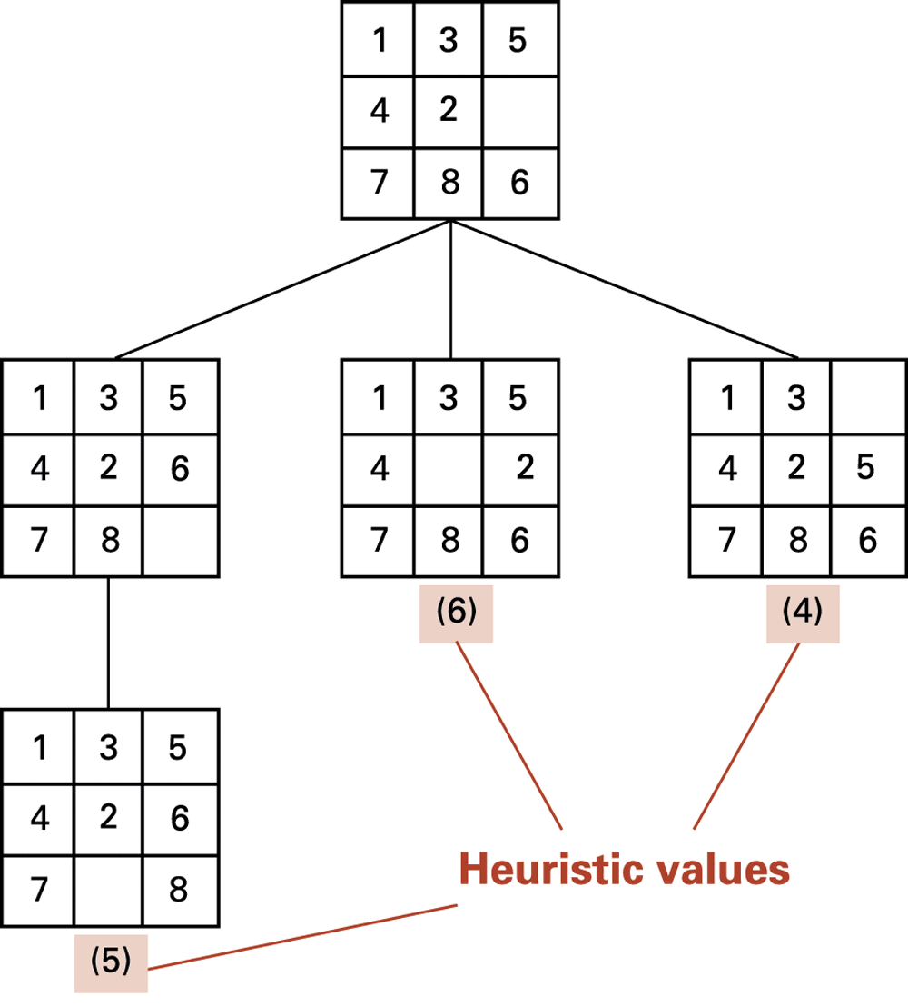
The search tree after two passes
0-<number>

Slide 45
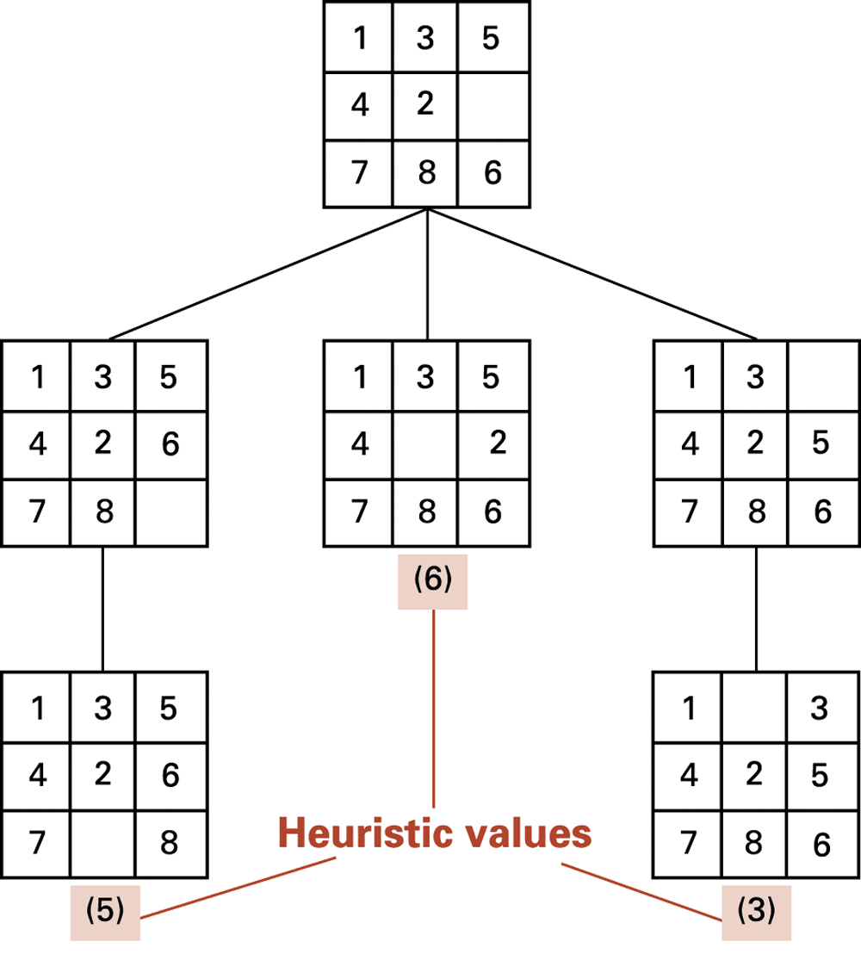
The search tree after three passes
0-<number>

Slide 46
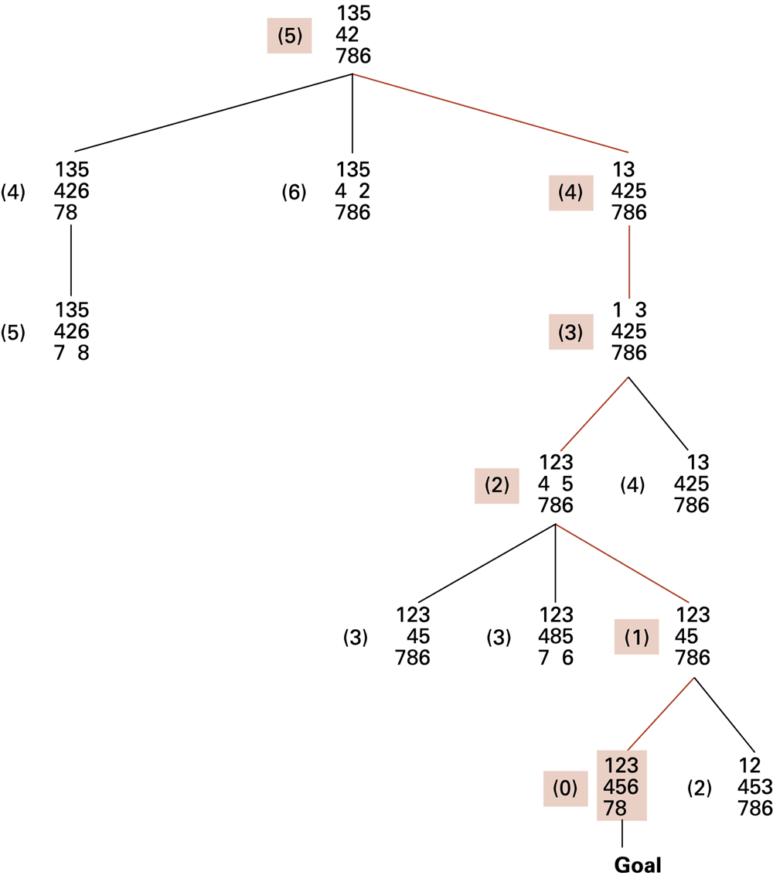
The complete search tree formed by our heuristic system
0-<number>

Slide 47

Thanks Bye ☺
0-<number>

